Slide 1
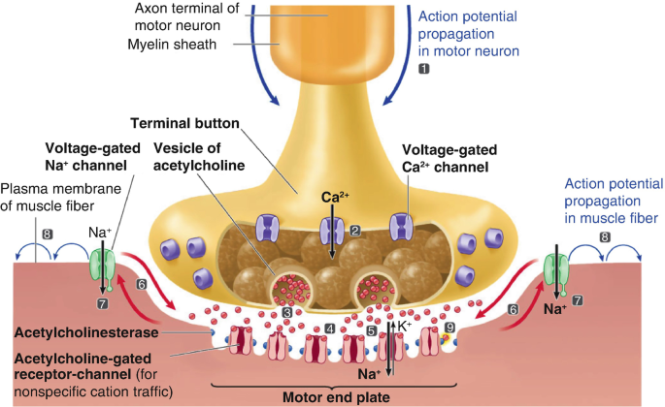
Skeletal Muscle Relaxants and Neuromuscular Blockade
Asses. Prof. Dr. Rafid Majeed Naeem

Slide 2
Muscle Relaxants and Neuromuscular Blockade
Muscle relaxants are a group of anesthetic adjuncts administered to improve relaxation of skeletal muscles during surgical or diagnostic procedures
مرخيات العضلات هي مجموعة من مساعدات التخدير التي تُحقن لتحسين استرخاء عضلات الهيكل العظمي أثناء العمليات الجراحية أو التشخيصية.
The neuromuscular blocking agents (NMBAs) action at the neuromuscular junction.
The more general term muscle relaxant refers to any drug having relaxant properties and would include centrally acting agents such as benzodiazepines, α2‐adrenergic receptor agonists
يشير مصطلح مرخي العضلات الأكثر عمومية إلى أي دواء له خصائص مرخية وايضا يشمل عوامل تعمل مركزياً مثل البنزوديازيبينات ، منبهات مستقبلات α2 ‐ الأدرينالية

Slide 3
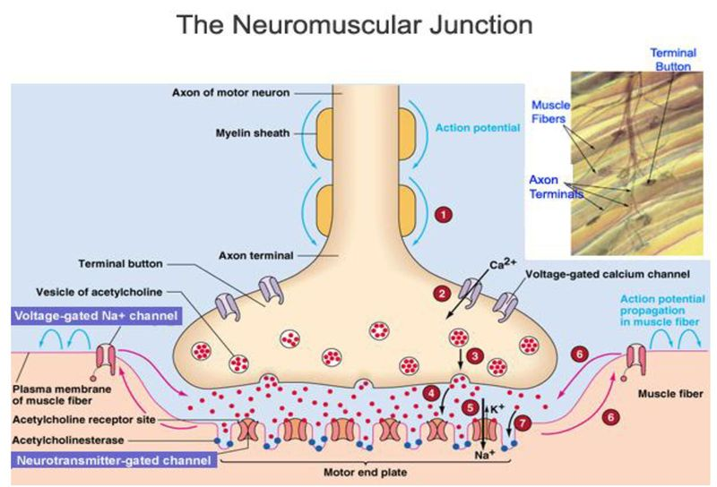

Slide 4
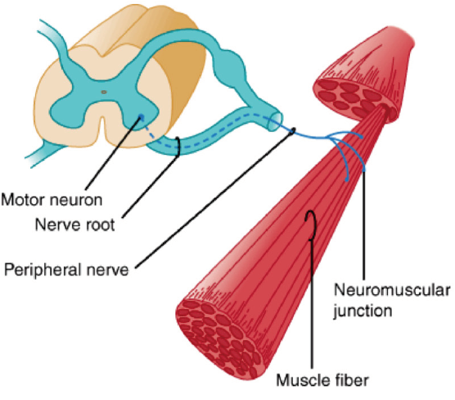
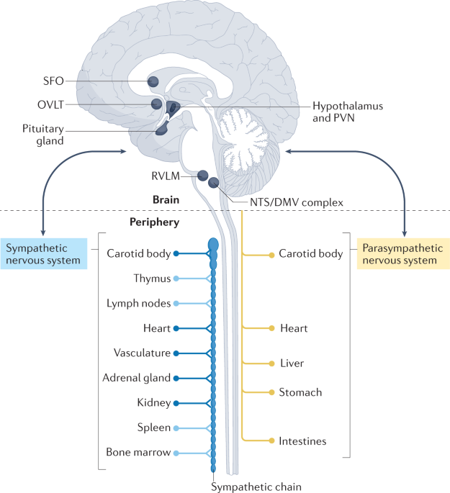
Skeletal muscles relaxants
Are drugs act peripherally at neuromuscular junction or muscles fiber it self or centrally in cerebro-spinal axis to reduce muscles tone/ and cause muscles paralysis.

Slide 5
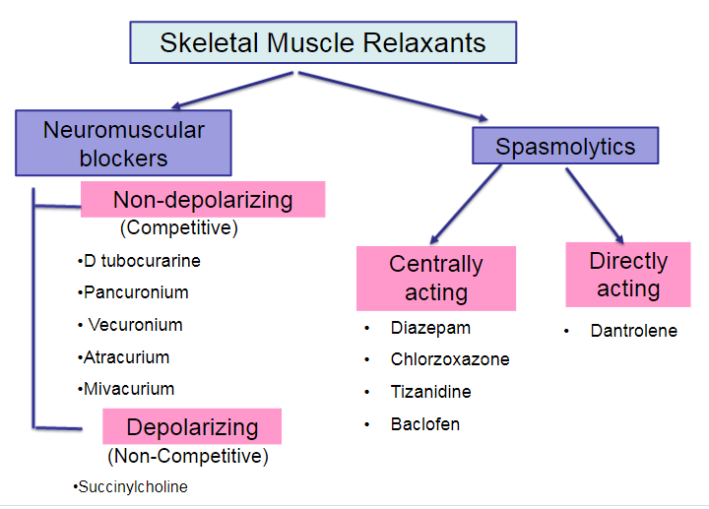
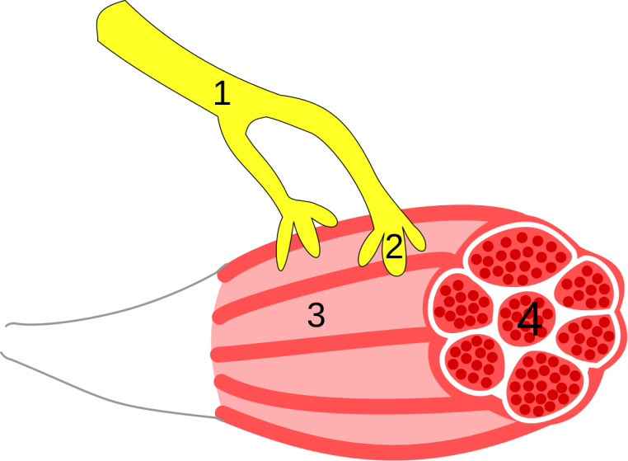
α2‐adrenergic receptor agonists

Slide 6
Various Drugs that effect skeletal muscles function
1. Neuromuscular blockers used in several procedures to cause muscles paralysis
NMBAs: completely paralyze skeletal muscles (from normal tone to zero)by interfering with acetylecholine at neuromuscular junction.
2. Centrally acting muscles relaxants reduce spasticity in neurologic conditions
Centrally acting drugs : used to relieve skeletal muscles spasm bring them from hypertonic state to normal muscles tone

Slide 7
Sequences of skeletal muscles paralysis
Small rapidly contracting muscles of face, eye, jaw, toes and larynx
Larger muscles like limbs , neck , trunk
Finally intercostal and lastly diaphragm
لذلك استخدام هذه الادوية (اذا زادت الجرعة) يؤدي الى فشل تنفسي... لازم عندنا احتياط mechanical ventilation
Recovery in reverse

Slide 8
Neuromuscular blocking drugs
They interfere with transmission with motor end plate and act post synaptically by one of the 2 mechanisms:
Non depolarizing blocking agents : competition with Ach. For the end plate receptor
2) Depolarizing blocking agents (noncompetitive)

Slide 9
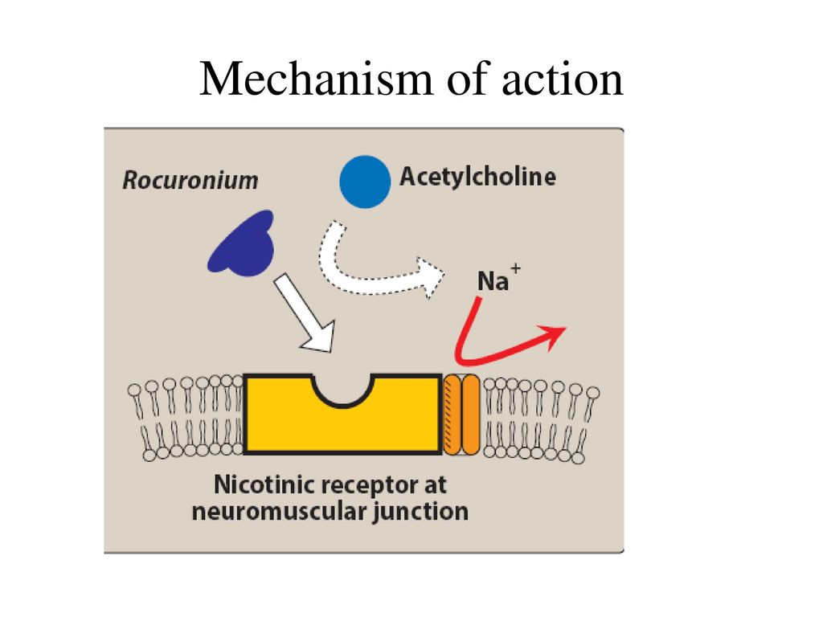
Type of NMBAs
1. Competitive blocker (non depolarizing agents)
These an affinity for the nicotinic receptor at the muscles endplate but have no intrinsic activity
ايهما تركيزه اعلى يفوز بالمستقبل
The antagonism is act by increasing the concetration acetylcholine by administration Neostigmin

Slide 11
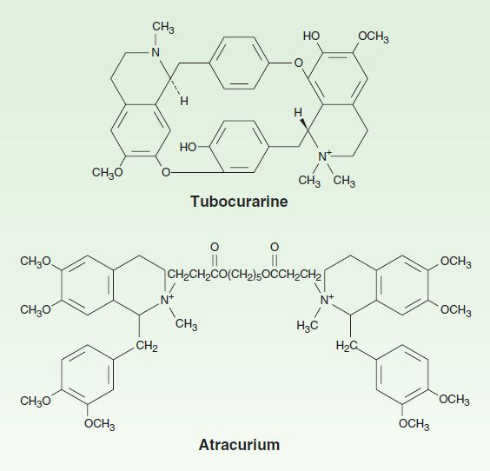
pharmacokinetic
The NMBAs are quaternary ammonium compounds designed to mimic the quaternary nitrogen atom of ACh. So its hydrophilic, not lipophilic therefore, it is administered in IV or IM rout and its not administered oraly.
They do not cross BBB and placenta

Slide 12
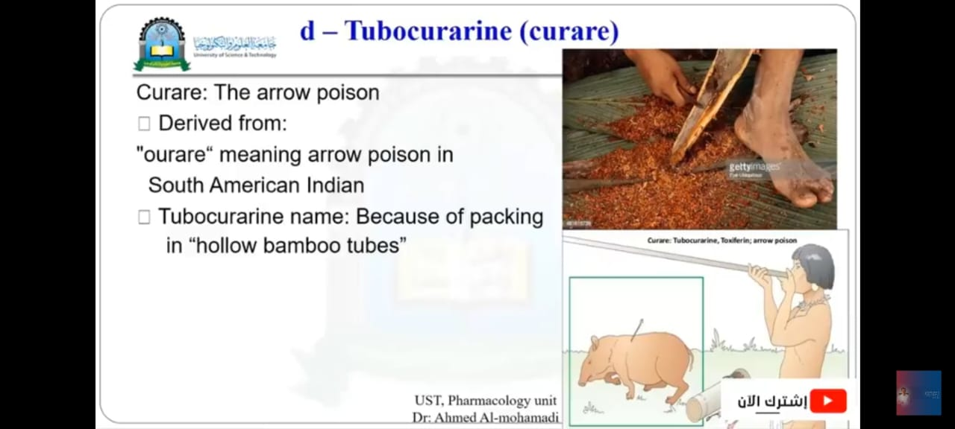
D-Tubocrarine (curare)
The first drug known to block the skeletal NMJ was curare [kyoo- RAH-ree], which native South American hunters of the Amazon region used to paralyze prey.
The effect of curare increases by
Aminoglycoside antibiotic like gentamycin and amicasin decrease Ach release
Halothan potentiate N M blocking
Side effects
Histamine release: hypotension and broncho consriction

Slide 13
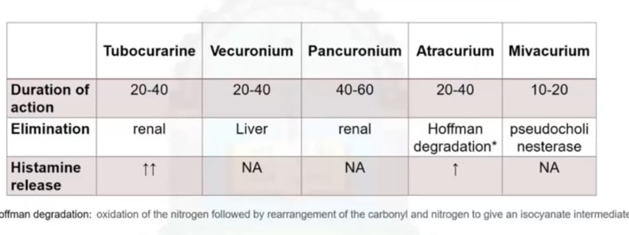
Non depolarizing NMBAs
Antidote: neostigmin (anticholineasrase)

Slide 14
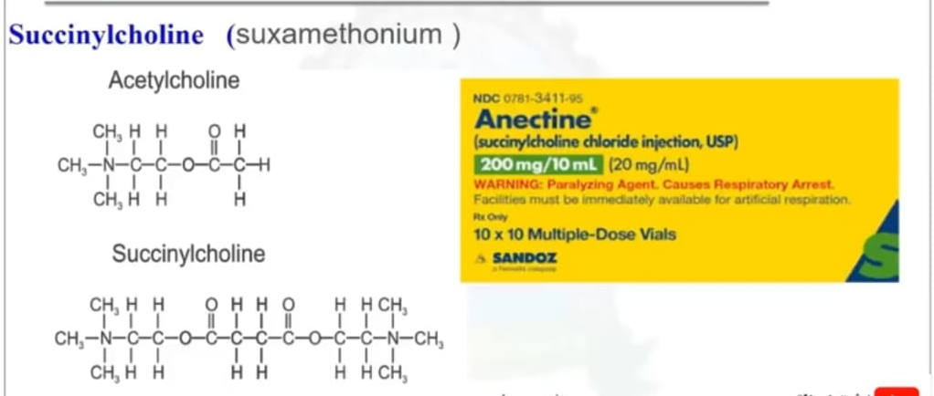
Non Competitive (depolarizing)
Succinylcholine is currently the only depolarizing NMBA used clinically in veterinary medicine.
حاليا هو NMBA الوحيد المزيل للاستقطاب المستخدم سريريا في الطب البيطري.

Slide 15
succinylcholine
Structurally, the succinylcholine molecule is two acetylcholine molecules joined together, or diacetylcholine.
من الناحية الهيكلية ، يكون جزيء السكسينيل كولين عبارة عن جزيئين من أسيتيل كولين مرتبطان معًا ، أو ثنائي أسيتيل كولين.
The drug is so rapidly hydrolyzed in plasma by the enzyme pseudocholinesterase (plasma cholinesterase) that only a small fraction of the original injected dose survives degradation in plasma to reach the site of action at the neuromuscular junction
يتحلل الدواء بسرعة كبيرة في البلازما بواسطة إنزيم الكولينستراز الكاذب (كولينستراز البلازما) بحيث لا ينجو سوى جزء صغير من الجرعة الأصلية المحقونة من التدهور في البلازما للوصول إلى موقع التأثير عند التقاطع العصبي العضلي.

Slide 16
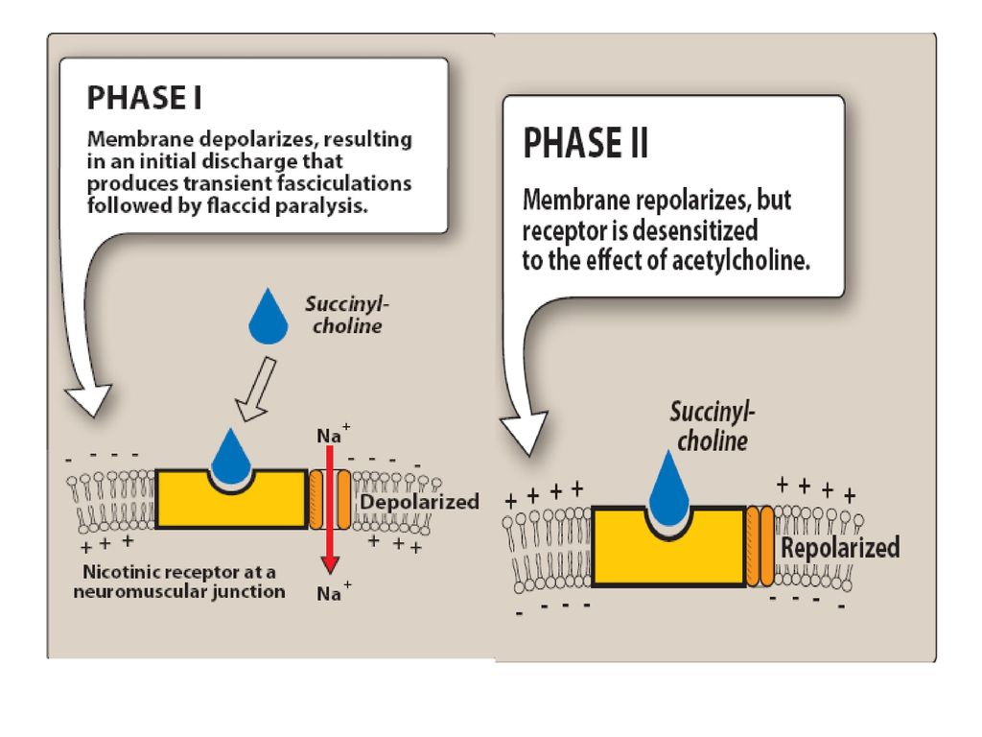

Slide 17
Phase I: depolarization phase:
succinylcholine has similar effect to act on Motor End Plate-open Na channel but it produced prolonged depolarization, thus it produce initial muscle stimulation (Fasciculation) follows by muscle paralysis
Recovery depends on wash out Sch from synapse and pseudocholinesterase in plasma
antidote: anticholinesterase will increase paralysis so contraindicated.
Phase II: desensitization phase:
not normal (complication)Occur during prolonged iv infusion or repeated iv injection of Sch..
Na channel closed leading to repolarization
Can use anticholinesterase (neostigmine) because repolarization Ach can bind to Nicotinic m. receptor.

Slide 18
succinylcholine
Because of the rapid onset of effect and short duration of action, succinylcholine is often referred to as the relaxant of choice to facilitate human endotracheal intubation
بسبب البداية السريعة للتأثير وقصر مدة المفعول ، غالبًا ما يشار إلى السكسينيل كولين باعتباره المرخي المفضل لتسهيل تنبيب الرغامي للإنسان.
Although succinlycholine has the advantage of rapid onset and offset compared with d‐tubocurarine, additional disadvantages of possible arrhythmias, postanesthetic myalgia الم عضلي

Slide 19
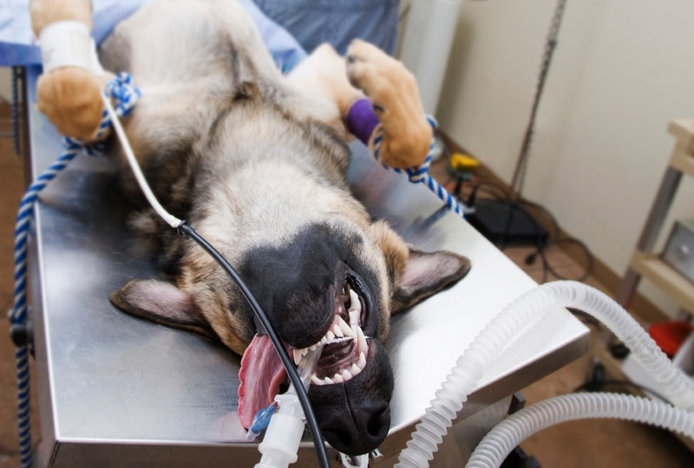
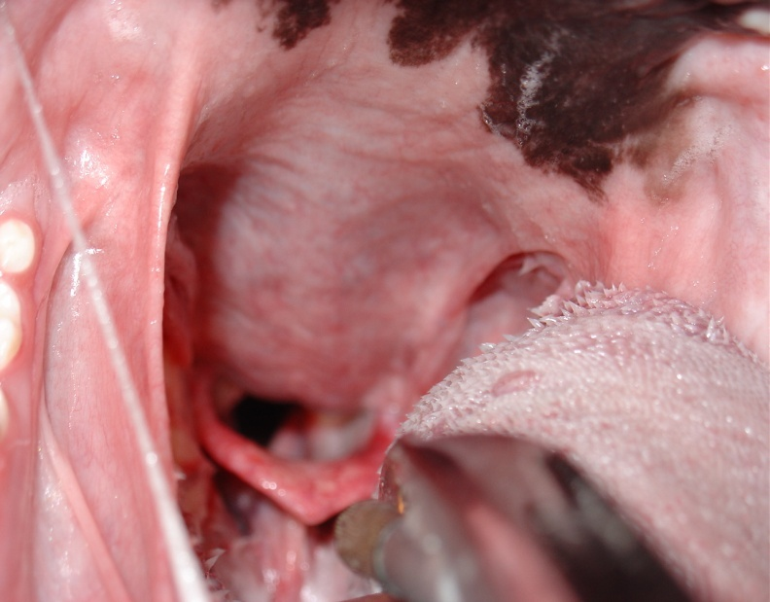
Beneficial effects of NMBA administration during general anesthesia include
facilitation of tracheal intubation
reduction of skeletal muscle tone at light planes of inhalant or injectable anesthesia,
prevention of patient movement during delicate ocular, neurologic, or cardiothoracic surgery
the use of NMBAs in general veterinary practice is limited.

Slide 20
triad of anesthesia
Inhalant anesthetics such as isoflurane are complete anesthetics in that they full the ‘triad of anesthesia’; that is, they provide unconsciousness, analgesia, and muscle relaxation. All three of these properties are required to permit most invasive surgical procedures.
إن أدوية التخدير المستنشقة مثل الأيزوفلورين هي أدوية تخدير كاملة من حيث أنها تحقق "ثالوث التخدير" ؛ أي أنها توفر فقدان الوعي ، والتسكين ، واسترخاء العضلات. كل هذه الخصائص الثلاثة مطلوبة للسماح بمعظم الإجراءات الجراحية الكبرى

Slide 21
inhalant anesthetics are very good at producing loss of consciousness at comparatively light planes of anesthesia while substantially deeper planes are required to provide analgesia and muscle relaxation
تعتبر أدوية التخدير عن طريق الاستنشاق جيدة جدًا في إحداث فقدان للوعي في مستويات التخدير الخفيفة نسبيًا بينما تتطلب مستويات أعمق إلى حد كبير توفير التسكين واسترخاء العضلات
Unfortunately, deeper planes of inhalant anesthetics are associated with a decrease in cardiovascular function, thus the properties of muscle relaxation and analgesia are accompanied by the adverse effect of reduced cardiovascular performance.
. لسوء الحظ ، ترتبط المستويات العميقة من أدوية التخدير الاستنشاقي بانخفاض في وظائف القلب والأوعية الدموية ، وبالتالي فإن خصائص استرخاء العضلات وتسكين الألم مصحوبة بالتأثير الضار لتقليل أداء القلب والأوعية الدموية.

Slide 22
Rather than using an inhalant anesthetic to provide all three components of the triad, a safer, smoother anesthetic technique, particularly in patients with cardiovascular compromise, may be one that uses:
low concentrations of inhalant anesthetic to provide unconsciousness,
opioids to provide analgesia, and
a NMBA to provide muscle relaxation.
Techniques such as this may be termed balanced anesthesia
.
Balanced anesthesia techniques are frequently chosen because they provide optimal conditions for both the surgeon and the patient
كثيرًا ما يتم اختيار تقنيات التخدير المتوازن لأنها توفر الظروف المثلى لكل من الجراح والمريض.

Slide 23


